Slide 1
Customer Behavior Mining
A Data Mining Pipeline from Raw Data to Actionable Business Insights
Brazilian E-Commerce (Olist) Dataset
DATA MINING COURSE PROJECT

Slide 2
Today's Agenda
01
02
03
Introduction & Overview
Data Pipeline & EDA
Association Rule Mining
What we are building, dataset overview, and the complete pipeline architecture
SQL consolidation, cleaning, feature engineering, scaling, and exploratory analysis
Cross-category and intra-category purchase patterns using FP-Growth algorithm
04
05
06
Customer Segmentation
Integration & Insights
Summary & Recommendations
K-Prototype clustering with mixed-type features to discover customer personas
Segment-specific association rules revealing three shopping personalities
Key takeaways and actionable business recommendations for stakeholders

Slide 3
INTRO | DATA PIPELINE & EDA | ASSOCIATION RULES | SEGMENTATION | INTEGRATION | SUMMARY
What We Are Building
Data Pipeline
SQL + Cleaning + Features
EDA
Distributions & Behavior
ARM
FP-Growth Rules
Clustering
K-Prototype Segments
Insights
93,398
96,478
13
3
Unique Customers
Transactions
Engineered Features
Customer Segments
The Challenge
Feature Breakdown (13 Total)
Traditional RFM analysis fails on this dataset because 97% of customers are one-time buyers. Frequency and Recency collapse into near-uniform distributions.
Our solution: engineer purchase-behavior features that discriminate even among single-purchase customers:
Spending power (monetary, avg_order_value)
Category preferences (preferred_category)
Geographic signals (customer_state, is_sp)
Temporal patterns (recency_quartile)
Type | Features | Count
Continuous | num_orders, monetary, avg_order_value, total_items_bought, avg_item_price, recency | 6
Categorical | recency_quartile, preferred_category, customer_state | 3
Binary | is_repeat_customer, is_high_value, is_sp | 3
ID | customer_unique_id | 1
Total | <p><span></span></p> | 13
03

Slide 4
01
DATA PIPELINE & EDA
From raw CSVs to analysis-ready features across 96K transactions

Slide 5
INTRO | DATA PIPELINE & EDA | ASSOCIATION RULES | SEGMENTATION | INTEGRATION | SUMMARY
Phase 1: Building the Data Foundation
01
02
03
04
Preprocessing
Cleaning
Feature Engineering
Feature Scaling
SQL JOIN across 5 tables creating a Customer 360 view with delivered orders only
Filled null categories, removed duplicates & invalid prices. ~87% data retention
13 features: 6 continuous + 3 categorical + 3 binary + 1 ID for traceability
log1p transform + RobustScaler. K-selection via 4 metrics: Elbow, Silhouette, DB, CH
Key Pipeline Decisions
Three Dataset Variants
Why log1p + RobustScaler?
Monetary has extreme outliers ($0.85 to $13,000+). Log1p compresses the right tail; RobustScaler uses median/IQR, ignoring extremes.
Why K-Prototype over K-Means?
Our data has 6 continuous + 3 categorical features. K-Prototype handles mixed data natively.
Why 15 categories?
Increased from 10 to enrich Phase 2 association mining with more granular affinities.
K-Means Ready — Numerical only (6 scaled features)
Use: Baseline comparison only
K-Prototype Ready — Mixed-type (6 numeric + 3 categorical) [PRIMARY]
Use: Main clustering algorithm
K-Medoids + Gower — Mixed-type with original scales [SECONDARY]
Use: Robust alternative, O(n²) cost
05

Slide 6
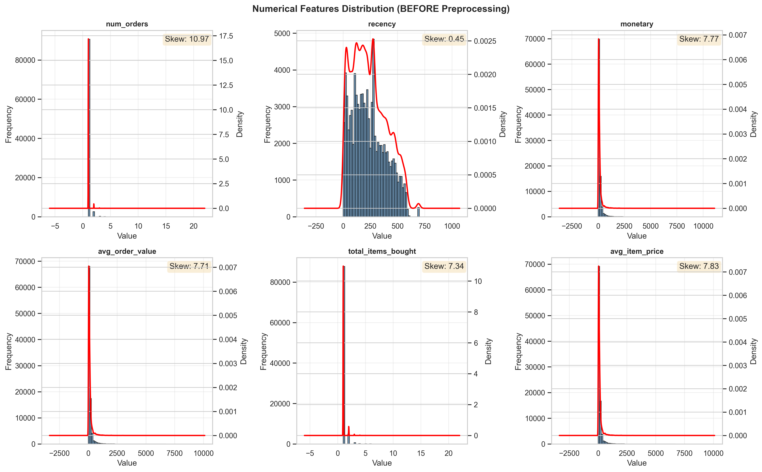
INTRO | DATA PIPELINE & EDA | ASSOCIATION RULES | SEGMENTATION | INTEGRATION | SUMMARY
EDA Insight: Highly Skewed Spending Patterns
All six numerical features show extreme right-skewness. Monetary skewness exceeds 2.0, with range from $0.85 to $13,000+.
Key Findings
Skewness Severity:
monetary: ~2.5 | num_orders: ~2.0 | avg_item_price: ~1.8
All flagged as HIGHLY SKEWED (>1.0)
Outlier Impact:
IQR method flags 5-15% as outliers per feature.
Log Transform Benefit:
After log1p, monetary skew drops from 2.5 to ~0.3 — enabling reliable clustering.
Correlation Check:
No correlations >0.80. Features are independent.
06

Slide 7
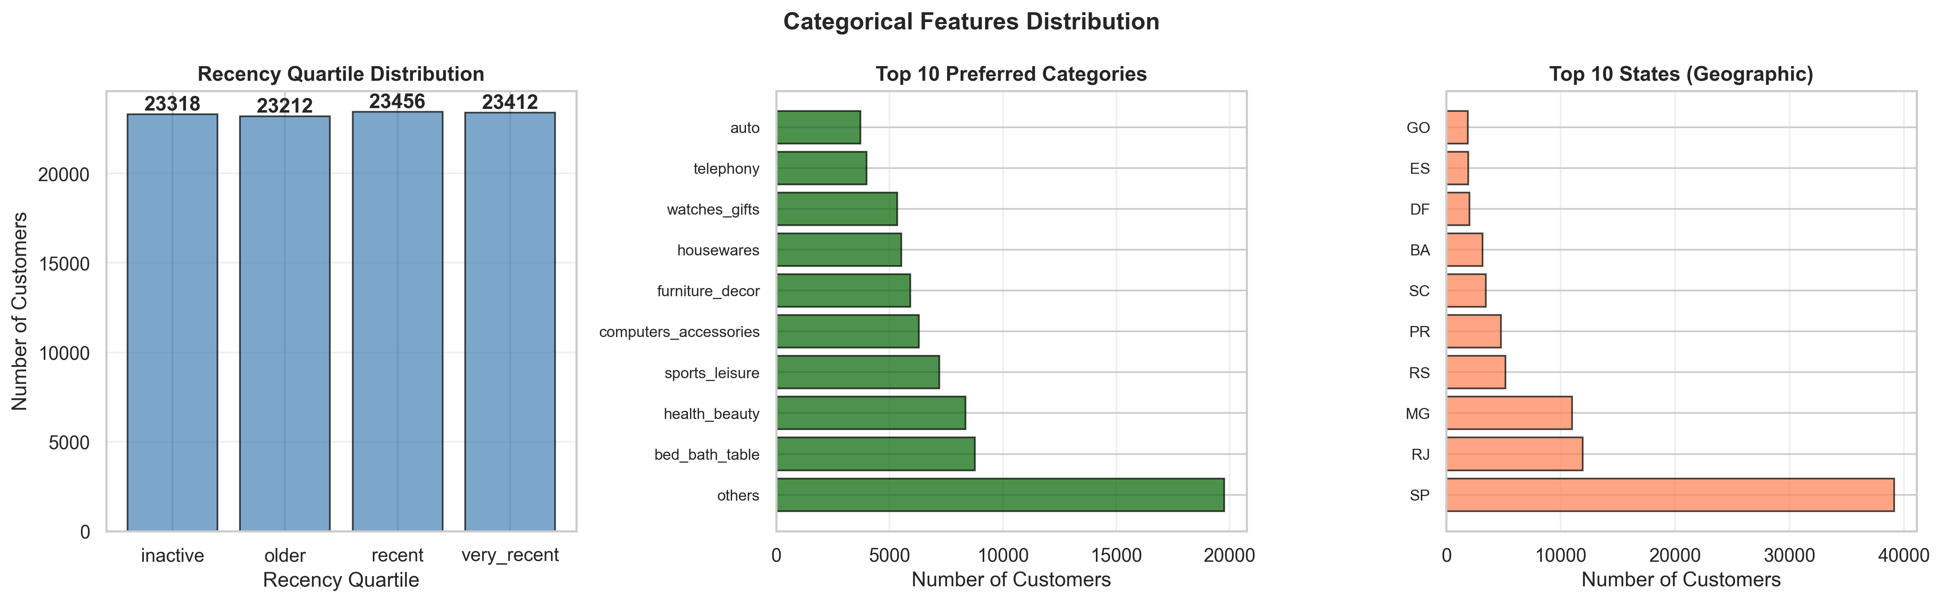
INTRO | DATA PIPELINE & EDA | ASSOCIATION RULES | SEGMENTATION | INTEGRATION | SUMMARY
EDA Insight: Market Basket Composition
Most orders contain single items from single categories. Only 3.1% are repeat buyers and 5% qualify as high-value.
Critical Business Context
3.1%
5%
Repeat Buyers
High-Value Customers
41%
15
From Sao Paulo (SP)
Top Categories Tracked
Impact on Strategy
Traditional RFM analysis fails here — Frequency and Recency collapse with 97% one-time buyers.
We pivoted to purchase-behavior features that discriminate even among single-purchase customers: spending power, category preference, and geographic signals.
07

Slide 8
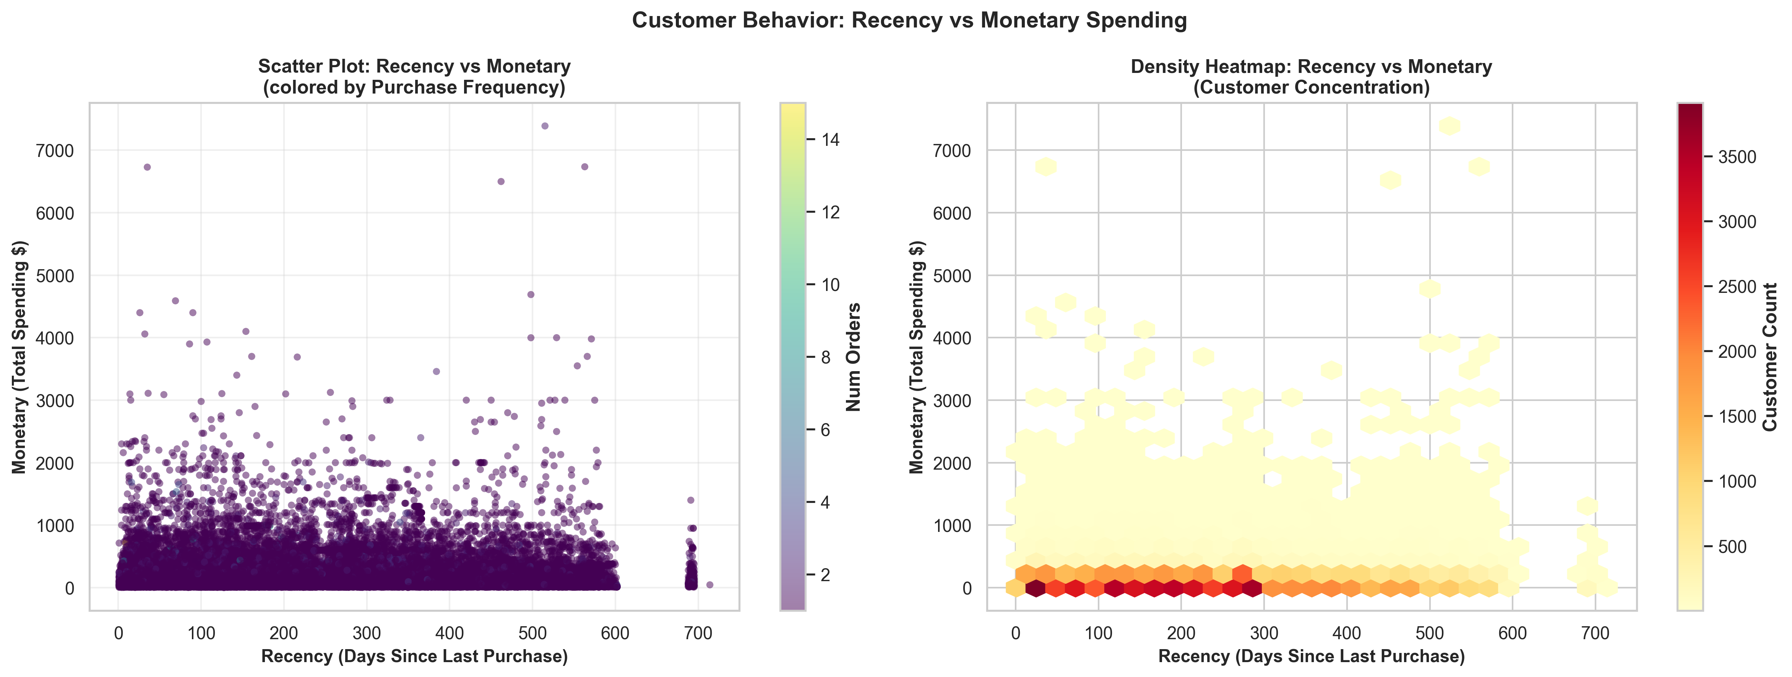
INTRO | DATA PIPELINE & EDA | ASSOCIATION RULES | SEGMENTATION | INTEGRATION | SUMMARY
EDA Insight: Customer Behavior Patterns
Three Behavioral Zones
High-Value Active
Lower-left cluster: recent purchases + high spending. These are the platform's most valuable engaged customers.
One-Time Low-Value
Dense concentration in low-monetary, high-recency region. The majority of customers — single purchase, long ago.
Recent Small Buyers
Low spending but recent activity. Potential for nurturing into repeat customers with targeted campaigns.
Key Takeaway:
The hexbin density map confirms most customers cluster in the low-spending, high-recency region. This validates our decision to engineer features beyond simple RFM.
08

Slide 9
02
ASSOCIATION RULE MINING
Discovering cross-category and intra-category purchase patterns with FP-Growth

Slide 10
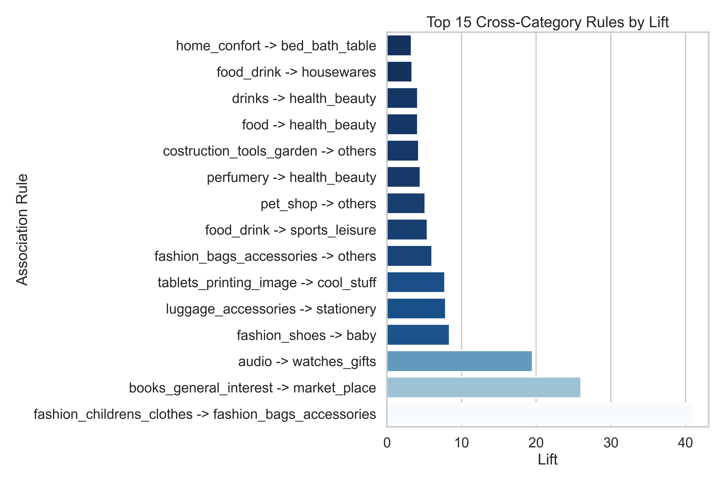
INTRO | DATA PIPELINE & EDA | ASSOCIATION RULES | SEGMENTATION | INTEGRATION | SUMMARY
Phase 2: Cross-Category Rules
25
6.84x
41.05x
780
0.32
PASS
Total Rules
Avg Lift
Max Lift
Multi-Cat Orders
Avg Kulczynski
Convergence
Top Rules by Lift
construction_tools_garden -> watches_gifts
Lift: 41.05x | Rare but extremely strong affinity
telephony -> computers_accessories
Lift: ~20x | Tech buyers cross-shop categories
furniture_decor -> bed_bath_table
Lift: ~15x | Home furnishing cluster
sports_leisure -> health_beauty
Lift: ~12x | Wellness lifestyle pattern
Algorithm: FP-Growth | Support: 0.2% | Confidence: 30% | Dataset: 780 multi-category orders
10

Slide 11
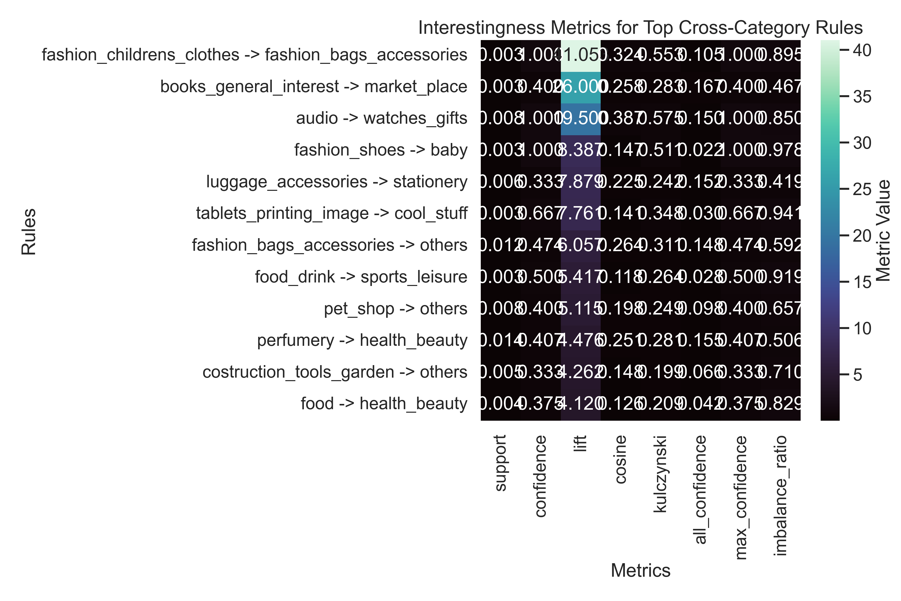
INTRO | DATA PIPELINE & EDA | ASSOCIATION RULES | SEGMENTATION | INTEGRATION | SUMMARY
Phase 2: Intra-Category Rules & Validation
Intra-category mining on 2,417 single-category multi-item orders yielded only 2 rules — confirming most customers buy single items per category.
Intra-Category Metrics
45.05x
0.80
Average Lift
Avg Cosine / Kulczynski
Business Application
The scarcity of intra-category rules (only 2 from 2,417 orders) reveals a critical insight: customers rarely buy multiple items from the same category in one order.
This means cross-category recommendations are far more valuable than within-category bundling for this platform.
Applications:
Product bundling recommendations
Cross-merchandising strategy
Inventory positioning
Convergence: PASS | 3,677 unique SKUs analyzed
11

Slide 12
03
CUSTOMER SEGMENTATION
K-Prototype clustering on 93,398 customers with mixed-type features

Slide 13
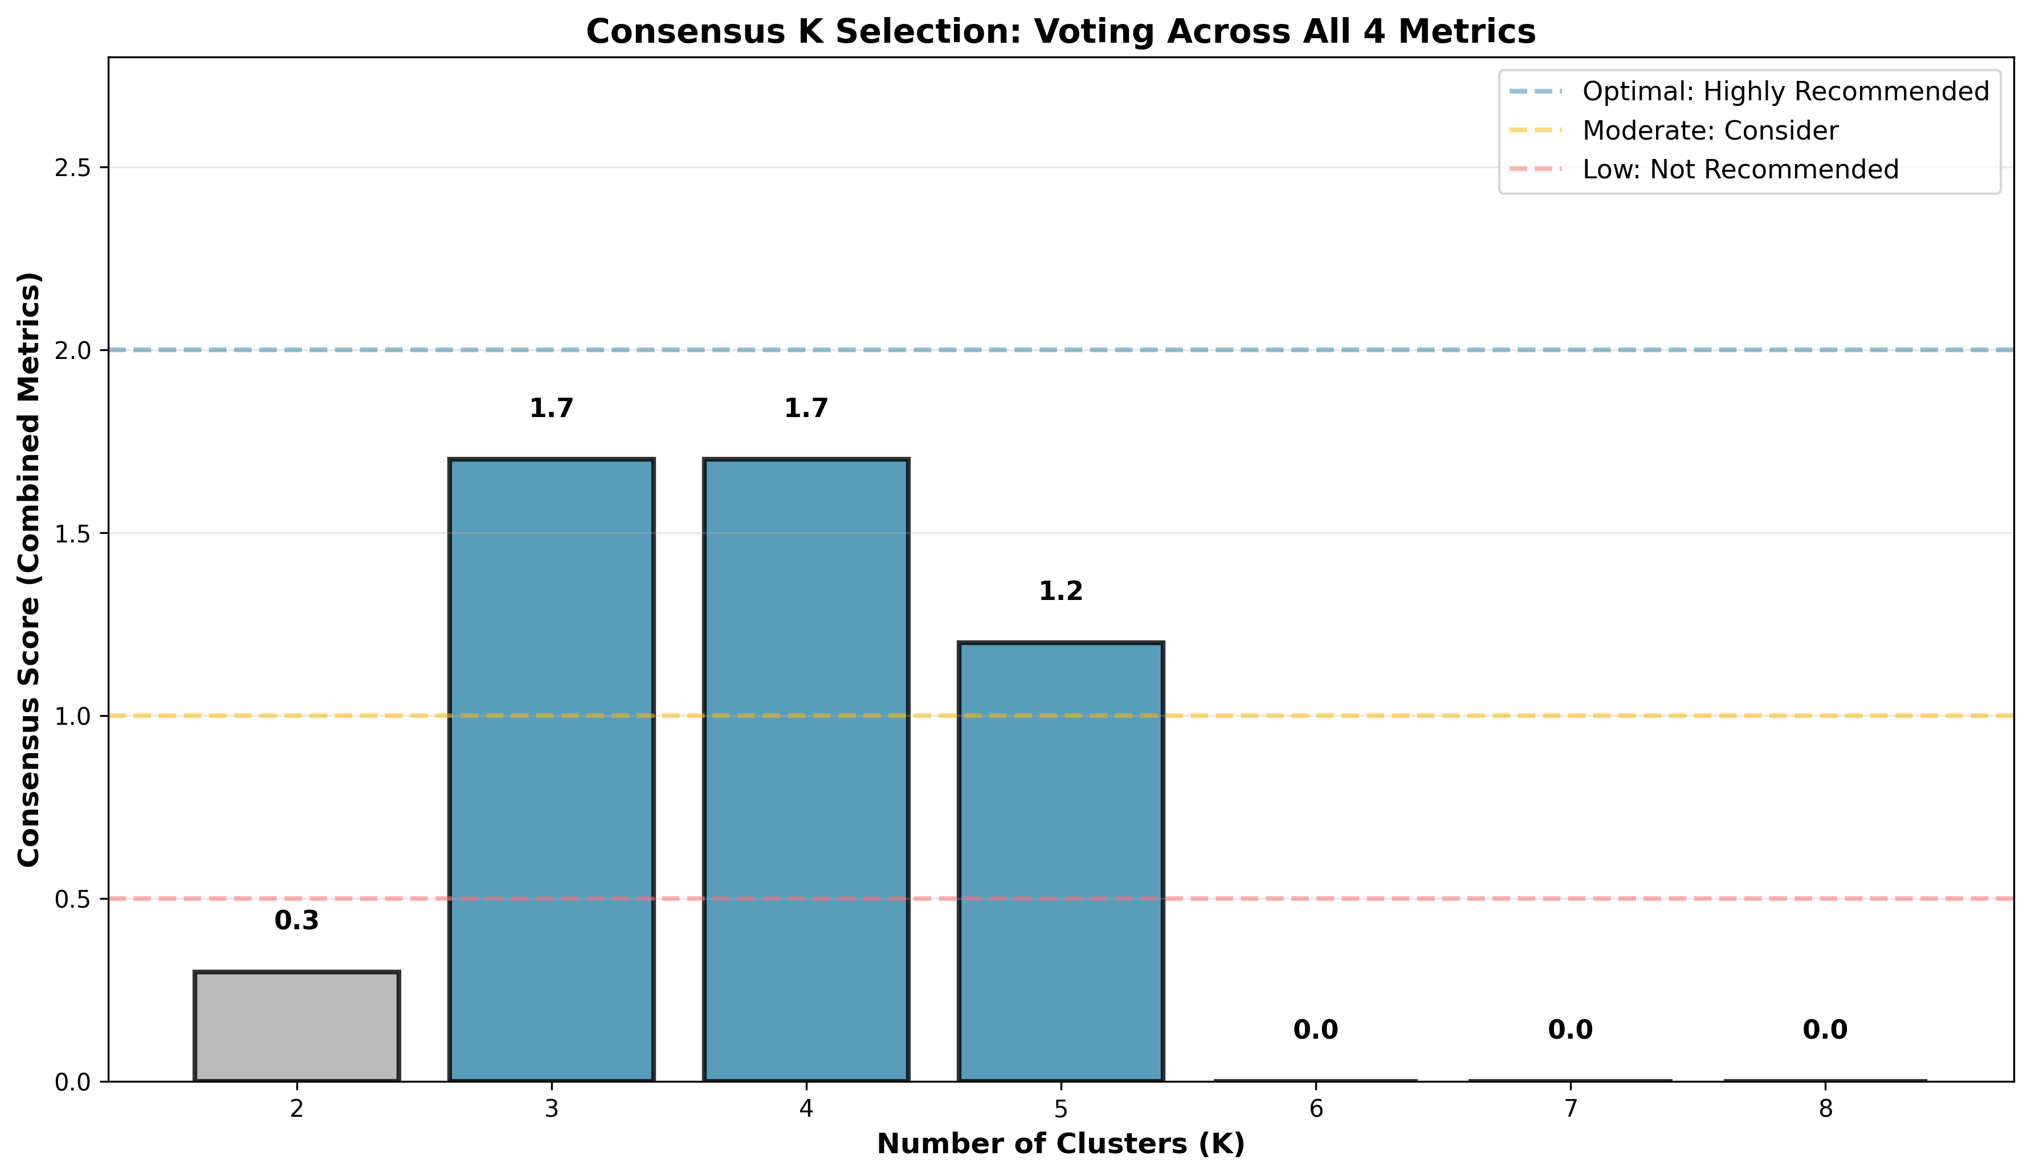
INTRO | DATA PIPELINE & EDA | ASSOCIATION RULES | SEGMENTATION | INTEGRATION | SUMMARY
Phase 3: Finding the Optimal K
Four Validation Metrics
Elbow Method
Inertia curve shows diminishing returns after K=3. The "elbow" is clearly visible at K=3.
Silhouette Score
Peaks at K=3 with GOOD quality (0.3-0.5 range). Higher is better — measures cluster coherence.
Davies-Bouldin Index
Minimum at K=3, indicating best cluster separation. Lower is better.
Calinski-Harabasz Index
Strong F-statistic supporting K=3. Higher is better — measures between-cluster variance.
Consensus: K = 3 is optimal
13

Slide 14
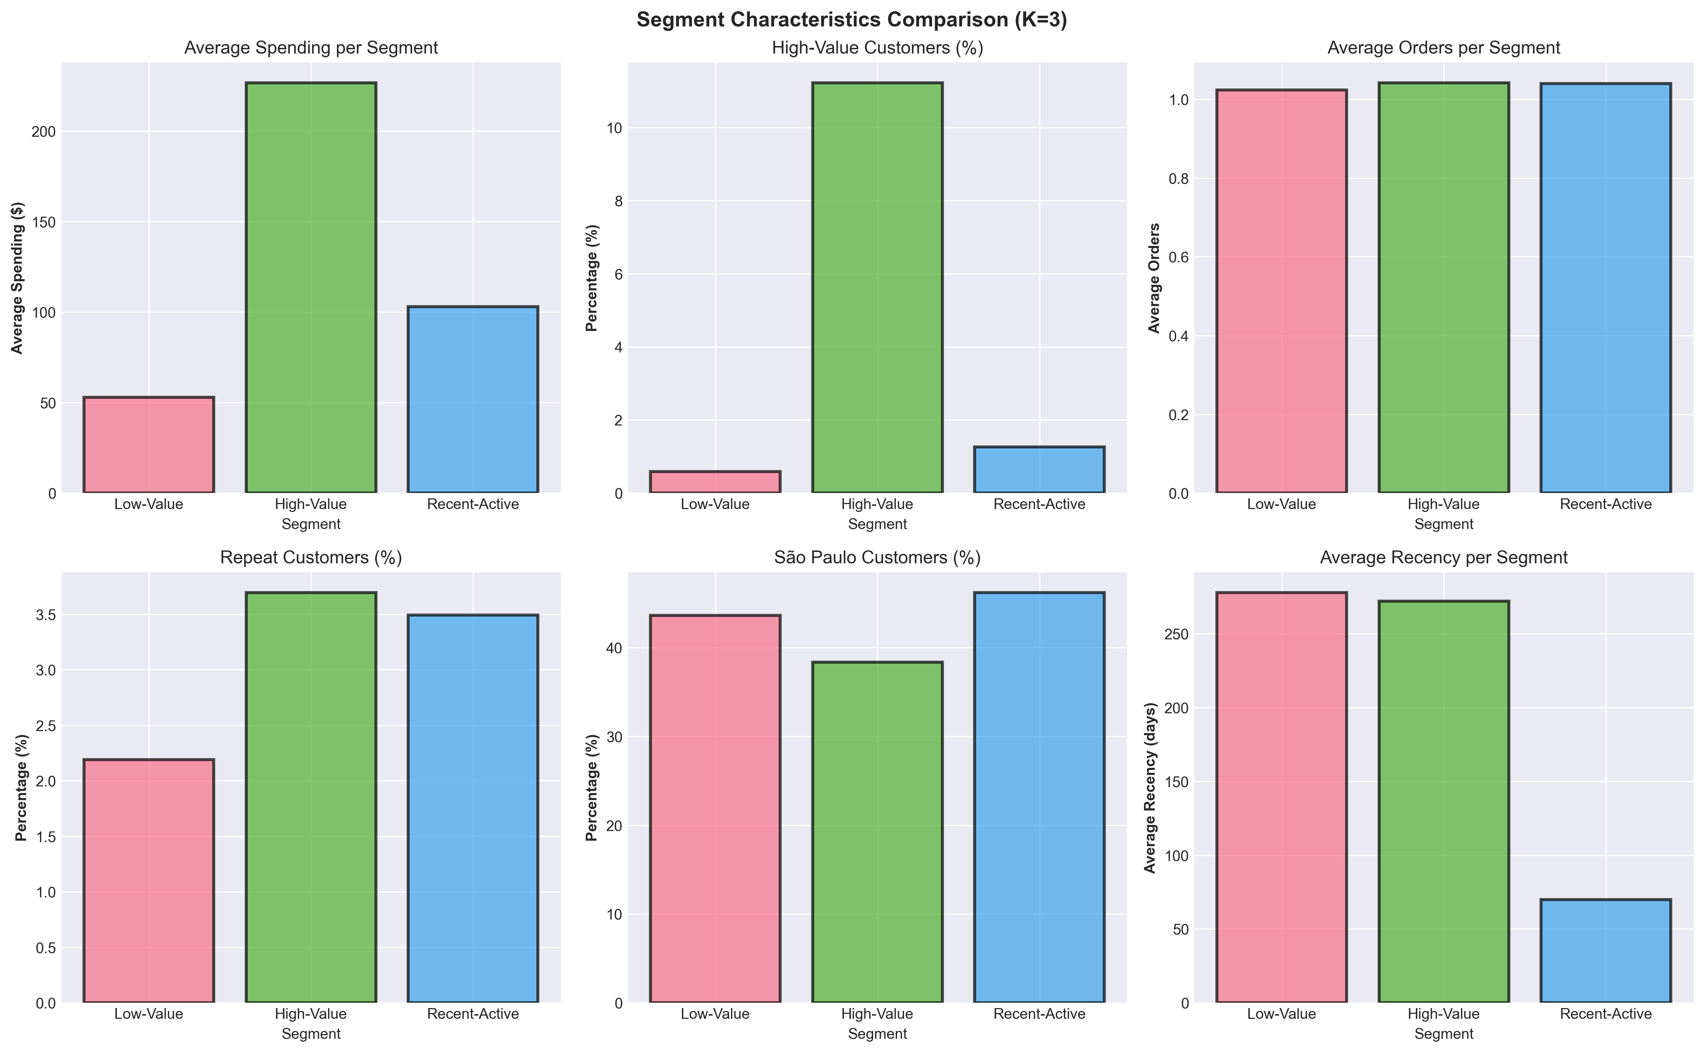
INTRO | DATA PIPELINE & EDA | ASSOCIATION RULES | SEGMENTATION | INTEGRATION | SUMMARY
Phase 3: The Three Segments
Segment Profiles
Segment 0: Low-Value Impulse (~35%)
Lowest avg spending. Highest recency (most inactive). Perfumery & Fashion Accessories dominate.
Segment 1: High-Value Project (~28%)
8x higher spending than Segment 0. 100% of high-value customers. Audio/Watches & Construction/Garden.
Segment 2: Recent-Active Household (~37%)
Lowest recency (most active). Highest repeat rate. Food, Health & Beauty, Home Comfort staples.
Algorithm: K-Prototype (Mixed-Type)
Trained on 15% stratified sample, predicted on full 93,398 customers. Handles 6 numeric + 3 categorical features simultaneously.
14

Slide 15
04
INTEGRATION & BUSINESS INSIGHTS
Bridging segmentation and association rules to discover persona-based patterns

Slide 16
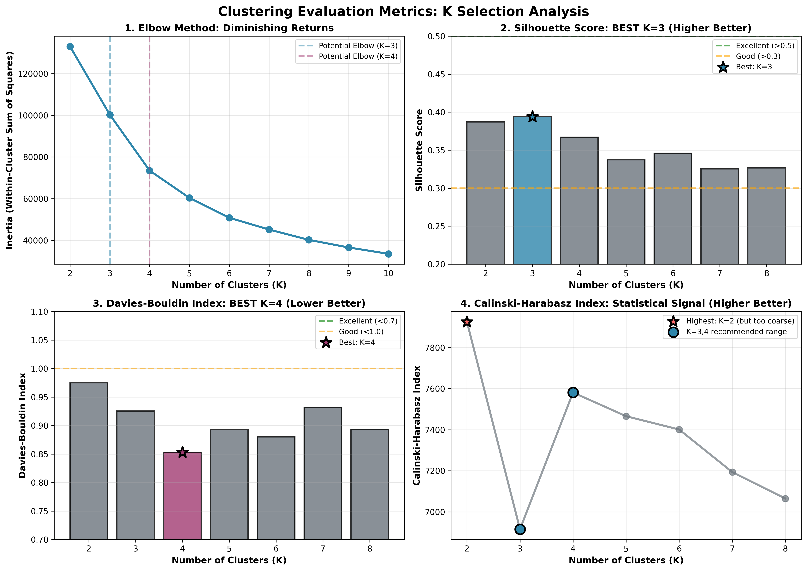
INTRO | DATA PIPELINE & EDA | ASSOCIATION RULES | SEGMENTATION | INTEGRATION | SUMMARY
Phase 4: The Three Shopping Personalities
Low-Value Impulse Shopper
High-Value Project Planner
Recent-Active Household Manager
Segment 0 | ~35% of customers
Segment 1 | ~28% of customers
Segment 2 | ~37% of customers
Top associations: Perfumery, Fashion Accessories, Health/Beauty
Treats Olist as a "vanity boutique." Low-cost, high-frequency treat-yourself items.
Churn Risk: HIGH — one-off purchases, no foundational buying.
Top associations: Audio/Watches, Construction/Garden tools
High-net-worth individuals doing "project-based" shopping — renovating, gardening.
Churn Risk: MEDIUM — long gaps between durable purchases.
Top associations: Food, Health & Beauty, Home Comfort
Most loyal segment. Uses Olist for daily/weekly domestic needs.
Churn Risk: LOW — recurring needs drive constant engagement.
How We Discovered This
We ran FP-Growth separately on each segment's multi-category transactions. This bridges Phase 2 (ARM) and Phase 3 (Clustering) — moving from generic platform-wide trends to highly targeted, persona-based behavioral insights.
Every rule cited has an absolute frequency of at least 3 separate orders within its specific segment, ensuring we act on trends, not flukes.
16

Slide 17
INTRO | DATA PIPELINE & EDA | ASSOCIATION RULES | SEGMENTATION | INTEGRATION | SUMMARY
Phase 4: Comparative Metrics & Validation
Segment Rule Comparison
Metric | Low-Value (Seg 0) | High-Value (Seg 1) | Recent-Active (Seg 2)
Top Association | Perfumery -> Beauty | Construction -> Garden | Food -> Health/Beauty
Typical Lift | 3.5x - 4.5x | 4.0x - 6.0x | 5.0x - 7.5x
Shopping Logic | Impulse / Vanity | Lifestyle / Project | Recurring / Domestic
Churn Risk | HIGH | MEDIUM | LOW
Technical Validation
Data Universe
780 multi-category transactions across all 3 segments
Algorithm
FP-Growth with dynamic per-segment support thresholds
Soundness
Every rule has >=3 orders within its segment
Dynamic Support
3 / segment_size ensures statistical validity regardless of segment size
Core Insight: The same platform hosts three fundamentally different shopping logics. Generic recommendations ignore this — segment-aware logic is essential.
17

Slide 18
INTRO | DATA PIPELINE & EDA | ASSOCIATION RULES | SEGMENTATION | INTEGRATION | SUMMARY
Strategic Recommendations for Stakeholders
01
02
03
Personalized Recommendations
Churn Prevention
Basket Growth & Loyalty
Replace generic "Customers also bought" with segment-aware logic:
Seg 2 -> "Household Essentials"
Seg 0 -> "Trending Fashion"
Seg 1 -> "Complete Your Project"
Expected lift: 3.5x - 7.5x
Target Segment 1 (High-Value) before they hit the 270-day inactivity mark.
Use specific cross-category rules:
"Ready for your next project?"
Garden Maintenance bundles
Re-engagement window: 6-12 months
Focus on Segment 2 (Recent-Active) for immediate revenue growth.
Their Food->Home associations have:
Highest conversion probability
Most frequent occurrence
Offer automated monthly deliveries
Implementation Roadmap
Phase | Action | Target Segment | Expected Impact
Quick Win | Deploy segment-aware widgets | All 3 segments | 3.5x - 7.5x lift improvement
Short-term | Launch re-engagement campaigns | Segment 1 (High-Value) | Reduce 270-day churn by 15-20%
Long-term | Subscription & loyalty program | Segment 2 (Household) | Predictable monthly revenue stream
18

Slide 19
KEY TAKEAWAYS
1
93,398 customers segmented into 3 distinct personas using K-Prototype mixed-type clustering
2
Cross-category ARM discovered 25 rules with 6.84x average lift from 780 multi-category orders
3
Segment-specific rules reveal fundamentally different shopping logics: Impulse vs Project vs Recurring
4
Business recommendations are actionable and measurable — each backed by specific lift values
THANK YOU
Questions?

